Slide 1
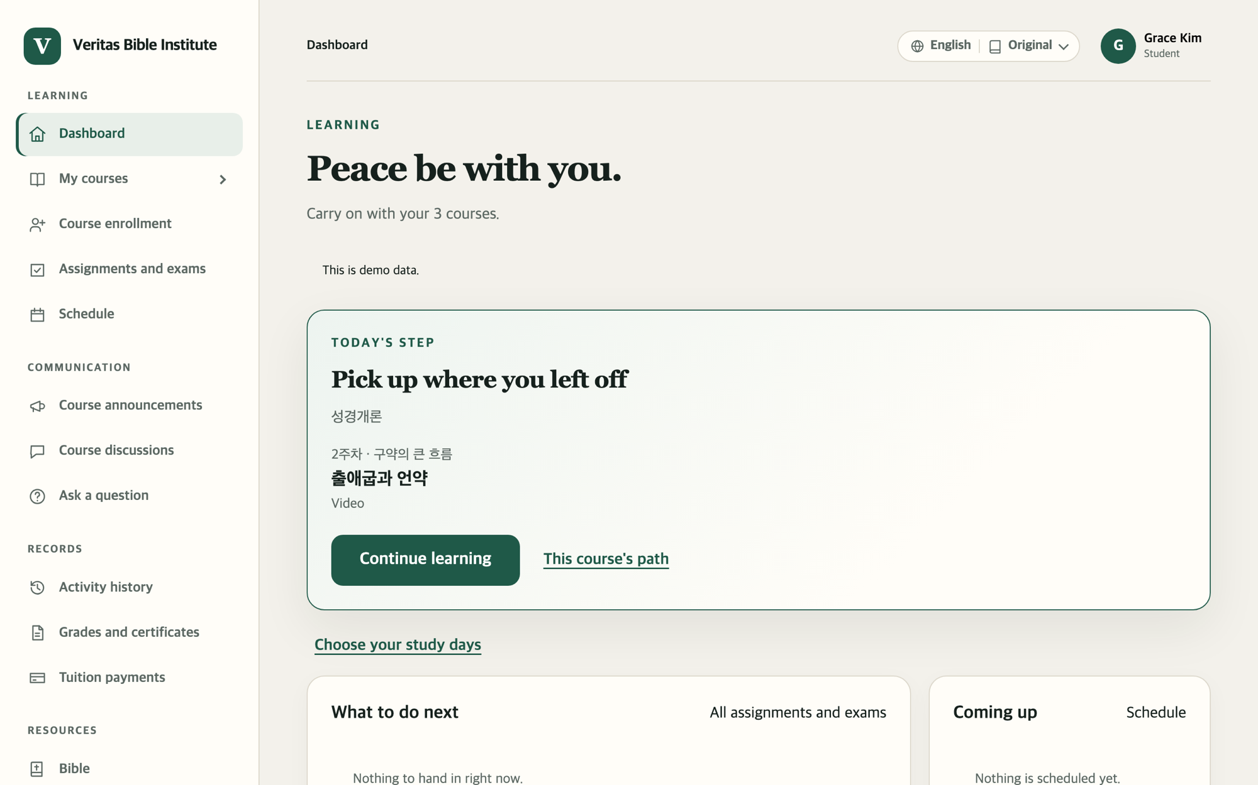
Using the
Online Campus
STUDENT GUIDE
New here? Turn one page at a time and follow along. That's all it takes.
Veritas Bible Institute · October 2026
Notes:
This guide walks a student through everything from the first visit to taking classes, handing in assignments and checking grades.

Slide 2

How to read this guide
BEFORE YOU START
1
Sign in
Orange number = click here
Bold words = button names
Stuck? Go to page 41
The numbers on the screen picture match the numbered steps beside it. Follow them in order.
Words in bold, like Sign in, are written exactly as they appear on the screen.
Check the common questions and where to get help. Take your time.
The pictures are sample screens. Course names and the student name may differ from what you see.
Online Campus Student Guide · p. 2
Notes:
Three promises of this guide: orange numbers show where to click, bold words are the button names on screen, and page 41 is the place to go when stuck.

Slide 3
Jump to the part you need
CONTENTS
Part 1 · p. 4
Part 2 · p. 10
Part 3 · p. 15
Part 4 · p. 20
Getting started
Finding your way
Enrolling and paying
Taking classes
Sign up, sign in, reset your password
Dashboard, menu, phone screen
Courses, free or paid, card
Video, reading, live Zoom
Part 5 · p. 27
Part 6 · p. 32
Part 7 · p. 36
p. 41
Assignments and exams
Staying in touch
Records and resources
When you're stuck
Announcements, discussions, questions
Schedule, grades, Bible, profile
Common questions, getting help
Handing in work, taking quizzes
Online Campus Student Guide · p. 3
Notes:
If this is your first time, go through Part 1 in order. If you already know how to sign in, jump to the part you need.

Slide 4
Getting started
PART 1
Finding the campus · Signing up · Signing in · Resetting your password
Online Campus Student Guide · p. 4

Slide 5




You need just three things
PART 1 · GETTING STARTED
A device online
Your email address
The campus address
A computer, tablet or phone all work. Video lessons are easier on a bigger screen.
Sign-up and password emails go here. A Gmail account makes it even easier.
Type the address campus staff gave you into the address bar at the top of your browser.
Once you're there, bookmark the page so you never have to type the address again.
Online Campus Student Guide · Part 1 Getting started · p. 5
Notes:
On a phone, open a browser app such as Safari or Chrome and type the address there.

Slide 6
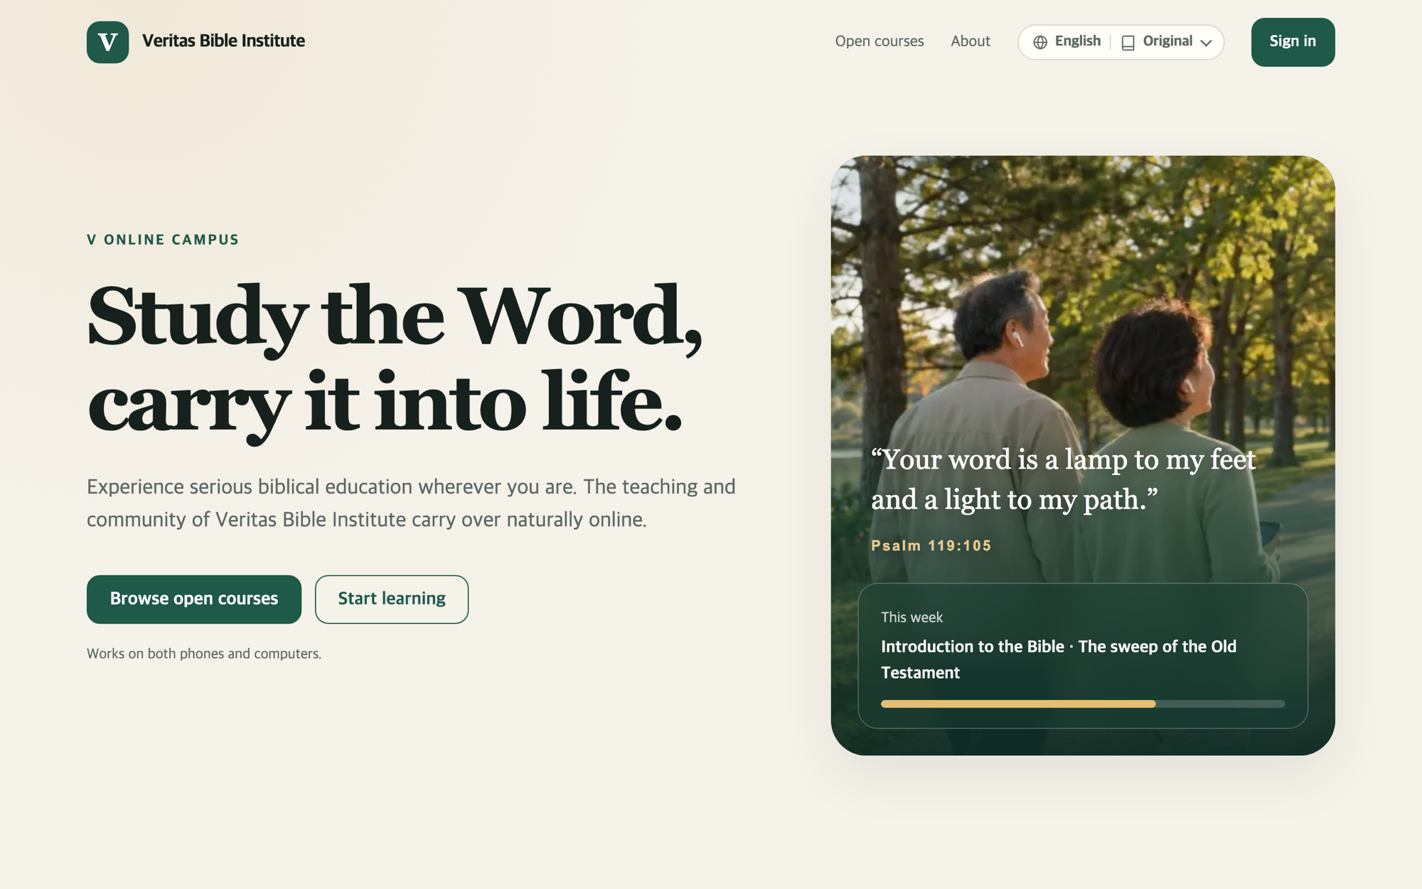
The campus home page
PART 1 · GETTING STARTED
1
Browse open courses
See the courses, instructors and tuition. No sign-in needed.
3
2
2
Sign in
First time? Click Create an account on the sign-in page. (next page)
3
Language menu
Click English to switch the screen to another language.
1
Online Campus Student Guide · Part 1 Getting started · p. 6
Notes:
Going to the campus address brings up this page. The Start learning button in the middle also leads to the sign-in page.

Slide 7
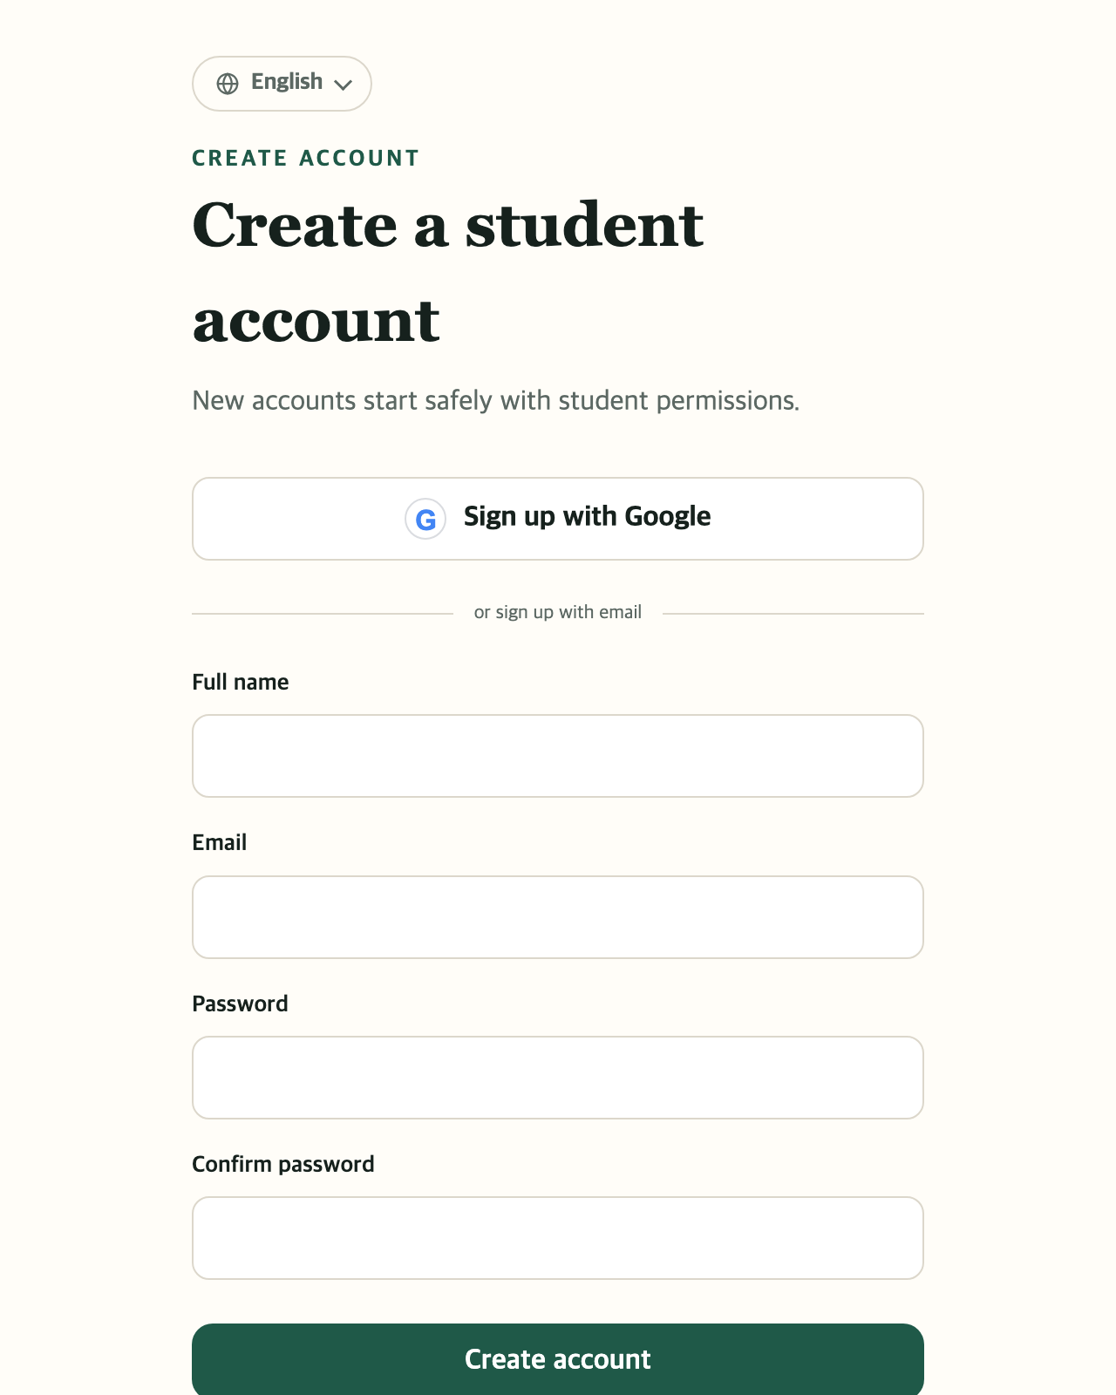

Signing up (just once)
PART 1 · GETTING STARTED
1
Have Gmail? Sign up with Google
Pick your Google account and you're done. Skip steps 2 and 3.
2
Otherwise, fill in four boxes
1
Full name (legal name), email, a password of 8+ characters, and the same password again.
2
3
Create account
If you see "We sent a confirmation email", open your inbox and click the link in it. Then you're signed up.
Your name is printed on transcripts and certificates. Please use your real name.
3
Online Campus Student Guide · Part 1 Getting started · p. 7
Notes:
New accounts start as student accounts. If the confirmation email doesn't arrive, check your spam or junk folder. You can also pick a course on the home page and click Create an account and enroll; the course you chose carries over after sign-up.

Slide 8
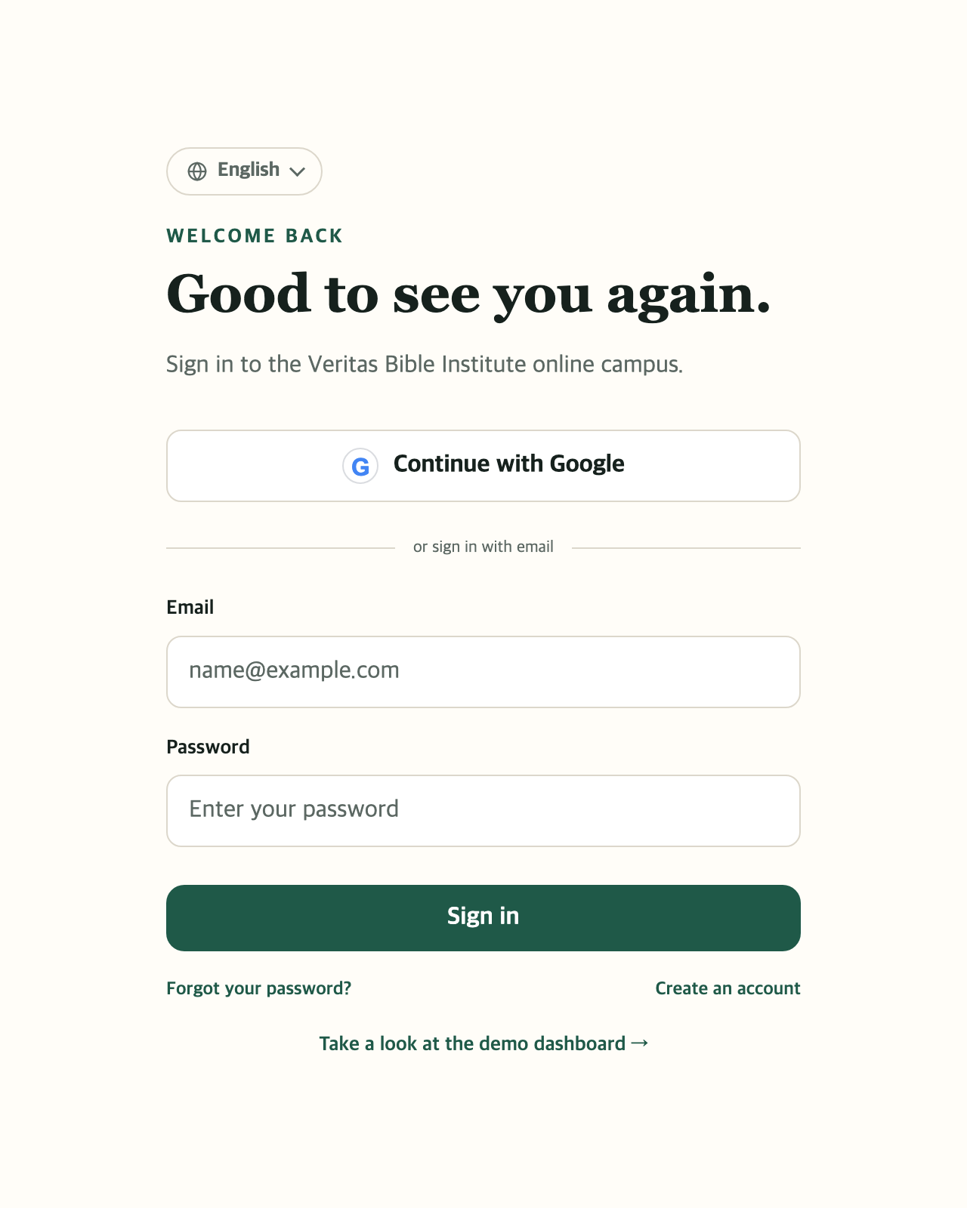
Signing in (every visit)
PART 1 · GETTING STARTED
1
Signed up with Google? Continue with Google
That's all. Skip steps 2 and 3.
2
Type your email and password
1
The ones you used to sign up.
3
Sign in
2
Your dashboard opens. (p. 11)
4
Forgot your password?
Click Forgot your password? (next page)
3
No account yet? Create an account at the lower right → p. 7
4
Online Campus Student Guide · Part 1 Getting started · p. 8
Notes:
If you signed up with Google, always come in with Continue with Google. If you signed up with an email, use your email and password. Mixing the two can create a second account, so keep using the way you chose first.

Slide 9
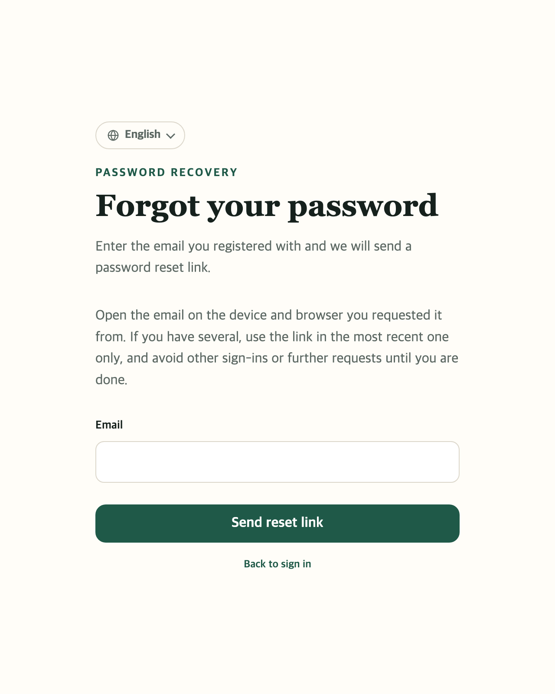
If you forget your password
PART 1 · GETTING STARTED
1
Type the email you signed up with
Forgot your password? on the sign-in page brings you here.
2
Send reset link
A password reset email arrives in your inbox.
3
Click the link in the email
Type a New password twice and click Change password.
1
4
Sign in with the new password
You're taken back to the sign-in page.
2
Open the email on the same device you asked from. If there are several, only the newest works. You can ask again after 60 seconds.
Online Campus Student Guide · Part 1 Getting started · p. 9
Notes:
Steps 3 and 4 happen after you open the email, so they have green numbers. If you signed up with Google, just sign in with Google instead of a password. If the email doesn't arrive, check your spam folder.

Slide 10
Finding your way
PART 2
Dashboard · Left menu · Your name at the top right · On a phone
Online Campus Student Guide · p. 10

Slide 11
The dashboard: your first screen after signing in
PART 2 · FINDING YOUR WAY
1
Left menu
The way to everything (next page)
1
5
2
Continue learning ★
Picks up right where you stopped
3
What to do next
Assignments and exams due soon
4
Coming up
Class and attendance dates
5
Your name
2
Profile, notifications, sign out (p. 13)
4
Click Dashboard on the left any time to come back here.
3
Online Campus Student Guide · Part 2 Finding your way · p. 11
Notes:
The dashboard shows today's work at a glance; Continue learning is the button you'll use most. If you aren't taking any course yet, a Browse courses button appears in its place. Choose your study days lets you pick the days you plan to study. Course and lesson titles appear in the language the instructor wrote them in. To read them in English, use the book (Original) menu at the top right; see page 13.

Slide 12
The left menu: what is where
PART 2 · FINDING YOUR WAY
Learning
Communication
Records
Resources
Dashboard
Your home screen
Course announcements
News from instructors and campus staff
Activity history
What you've done
Bible
Read, listen, reading plan
My courses
Courses you're taking
Grades and certificates
Transcript, certificates
Course discussions
Talk with classmates
Course enrollment
Sign up for a course
Tuition payments
Pay, get receipts
Ask a question
Ask an instructor or campus staff
Assignments and exams
Your to-do list
Schedule
Calendar, your events
Online Campus Student Guide · Part 2 Finding your way · p. 12
Notes:
Click the small arrow beside My courses to see the names of the courses you are taking, and open one directly from there.

Slide 13
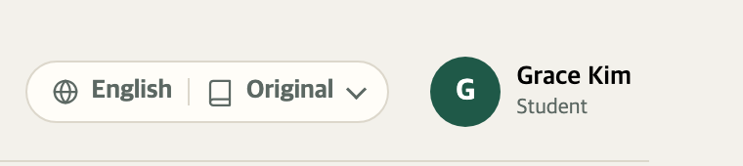

Top right: language and your name
PART 2 · FINDING YOUR WAY
1
2
My settings
My profile · p. 40
Notifications and settings · p. 35
1
Language menu
Help · p. 42
Click the globe (English) to change the language of menus and buttons.
Sign out
You can read lessons in translation. Even if a course is written in another language, click the book (Original) and pick a language under Lesson language: titles, text, quizzes and assignments then appear in that language. Anything not yet translated appears as written.
On a shared computer, always sign out when you finish.
2
Click your name → the menu on the right opens
When something is unread, New notifications appears to the left of your name. Click it to read them.
Online Campus Student Guide · Part 2 Finding your way · p. 13
Notes:
Lesson translation: the book menu appears only when campus staff have turned translations on. A translated page carries the note "This is a translation. Where the meaning is unclear, the original is authoritative." Choosing Original again switches back to the language the instructor wrote in. The white box on the right is a drawn copy of the menu that opens when you click your name. People who are also instructors or administrators see Switch role there too; students don't.

Slide 14
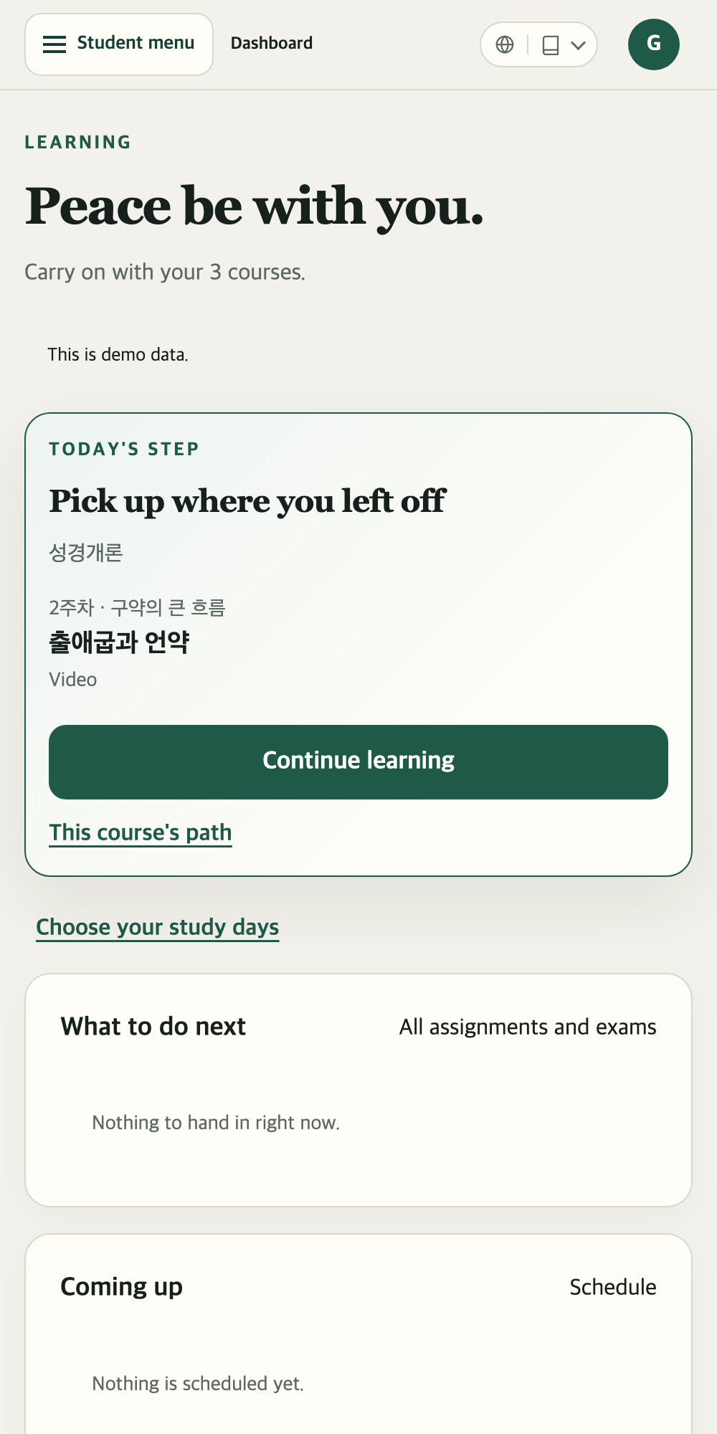
On a phone
PART 2 · FINDING YOUR WAY
1
2
1
☰ Student menu
The left menu hides here. Tap to open it; tap Close or anywhere outside to fold it away.
2
The circle with your first initial
Same as your name on a computer: profile, notifications, sign out.
3
Everything else works the same
Swipe up with your finger to see more.
For long assignments or uploading files, a computer is easier.
Online Campus Student Guide · Part 2 Finding your way · p. 14
Notes:
On a narrow phone screen the left menu moves into the Student menu button. There's no app to install; open the campus address in your phone's browser.

Slide 15
Enrolling and paying tuition
PART 3
Choosing a course · Free or paid · Paying by card
Online Campus Student Guide · p. 15

Slide 16
Signing up for a course
PART 3 · ENROLLING AND PAYING
1
Click Course enrollment in the left menu
You'll see a card for each course open for sign-up.
Enrolling
BI101
2
Check it with See the curriculum
Introduction to the Bible
See what you'll study, week by week.
12 lessons · 8 seats left
3
Click the sign-up button
Enroll and pay
Enroll for free for a free course, Enroll and pay for a paid one.
See the curriculum
Afterwards the same spot shows Go to the course, or Continue to payment if you haven't paid yet.
▲ Sample course card
Online Campus Student Guide · Part 3 Enrolling and paying · p. 16
Notes:
The card on the right is a drawn sample. Before signing in you can also browse the same courses with Browse open courses on the home page; then choose Create an account and enroll, or Sign in and enroll. A course with no seats left shows Full.

Slide 17


What happens after you sign up?
PART 3 · ENROLLING AND PAYING
Free course
It goes straight into My courses. You can start right away.
Paid · card
Pay by card in Tuition payments
The course opens as soon as payment is confirmed
Paid · Zelle/Venmo
Send the money, then click I've sent it
The course opens once campus staff confirm it
A paid course shows up in My courses only after payment. If a course is missing, check Tuition payments first.
Online Campus Student Guide · Part 3 Enrolling and paying · p. 17
Notes:
Signing up for a paid course takes you to Tuition payments automatically. A card payment opens the course right away; a transfer opens it once campus staff have seen the money arrive.

Slide 18
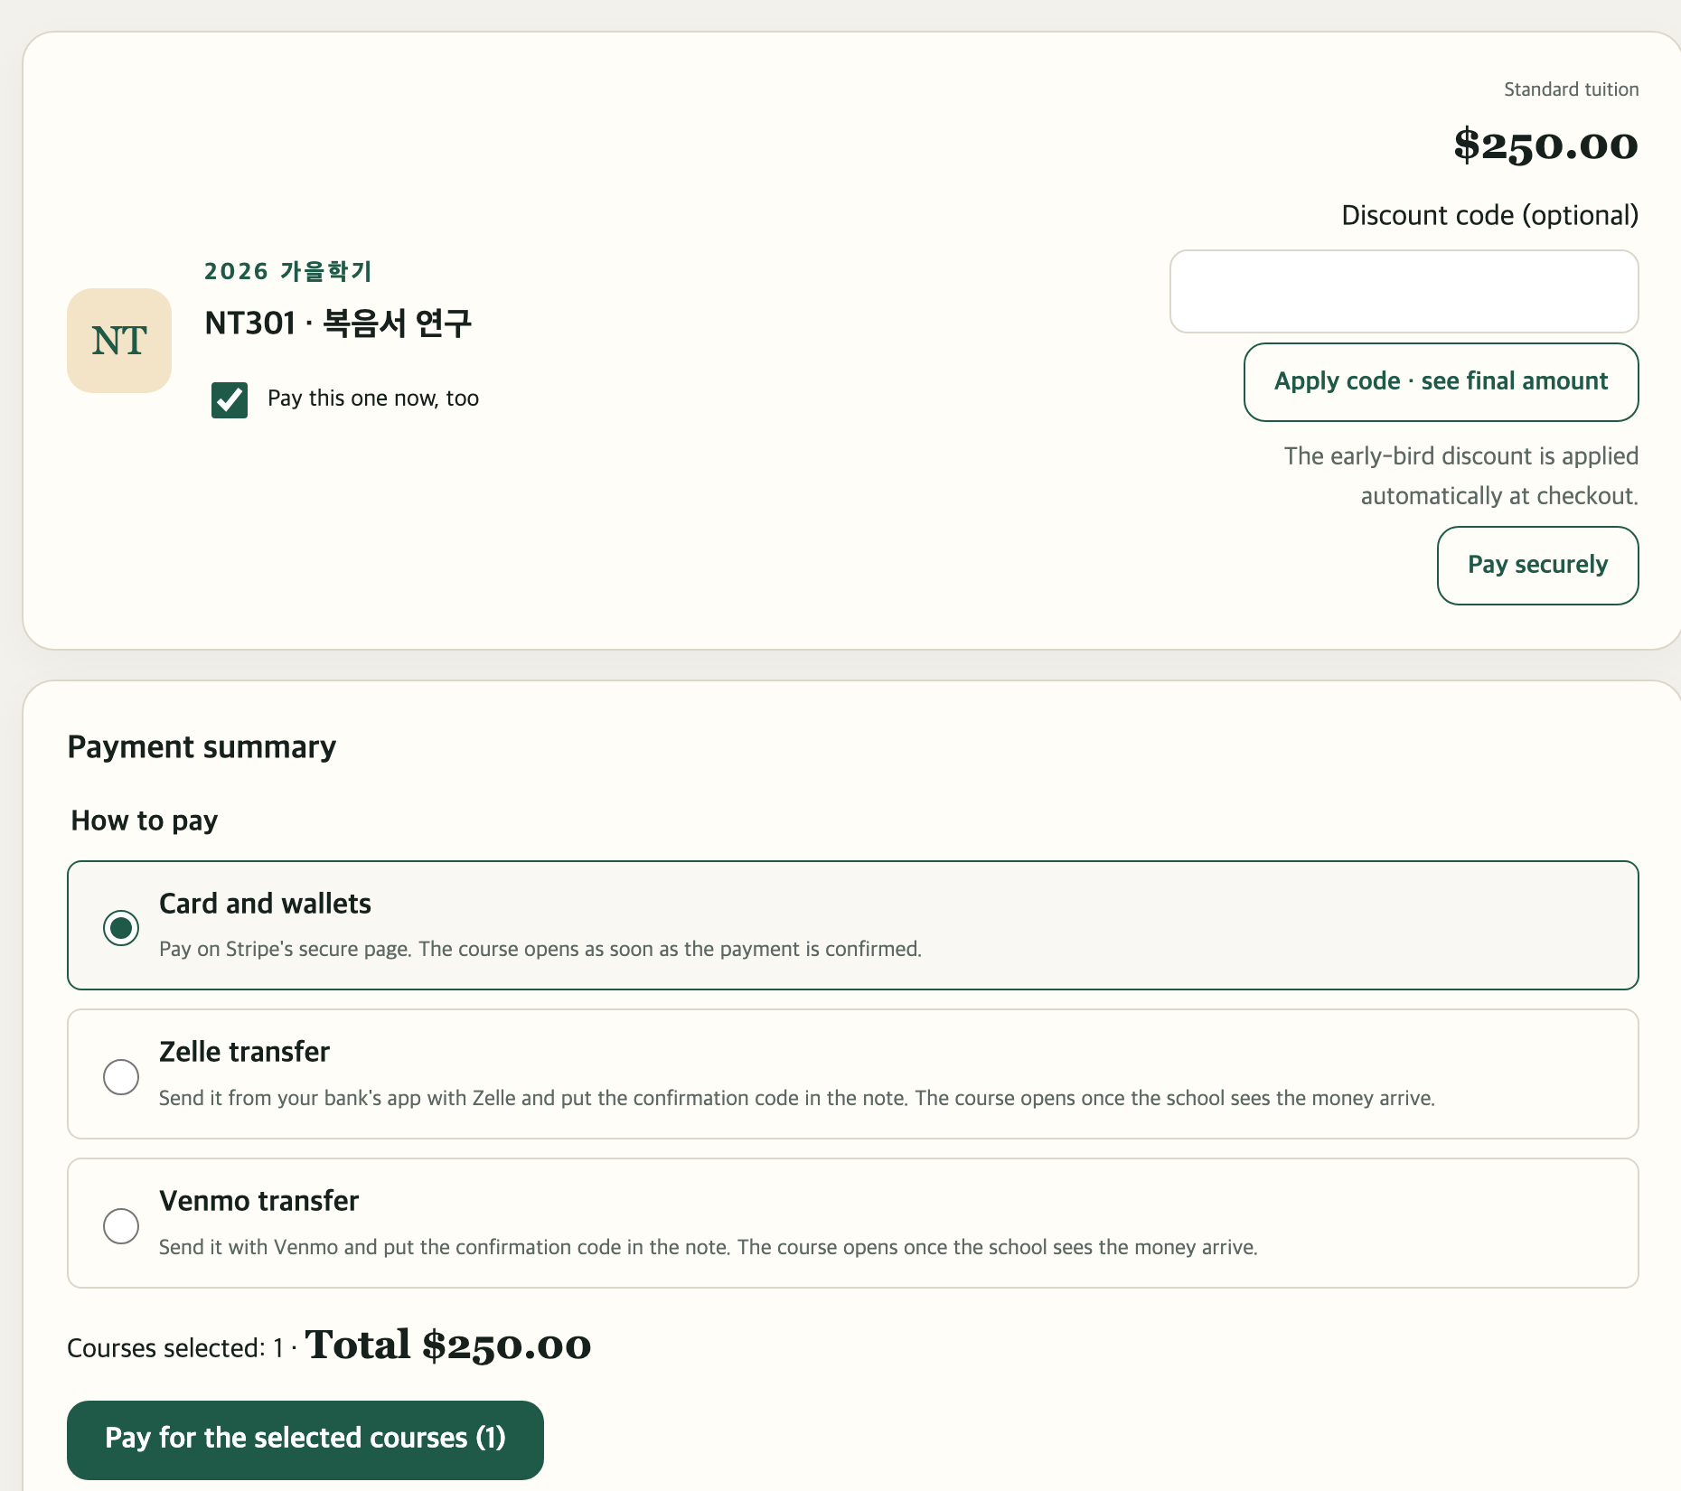
Paying tuition
PART 3 · ENROLLING AND PAYING
Click Tuition payments in the left menu to open this page.
1
1
Tick the course to pay for
Pay this one now, too. You can pay for several at once.
2
Choose How to pay
Card and wallets, Zelle transfer or Venmo transfer.
2
3
Pay for the selected courses
A card opens a secure payment window. For a transfer, see the next page.
Have a discount code? Enter it first and click Apply code · see final amount.
3
Online Campus Student Guide · Part 3 Enrolling and paying · p. 18
Notes:
For a single course you can also click Pay securely on that course's card. Early-bird discounts apply automatically at checkout. Card numbers are entered on the secure page of Stripe, the payment company, not on the campus site.

Slide 19

Paying by Zelle or Venmo · Getting a receipt
PART 3 · ENROLLING AND PAYING
1
2
3
Get transfer instructions
Send the money
Click I've sent it
Receipt
In your bank app or Venmo, send the amount shown. Put the confirmation code in the memo. There's a Copy button.
Back on the campus page. The course opens once campus staff confirm the transfer.
Under Payment history on the same page, click Download in the Receipt column.
Choose Zelle or Venmo under How to pay, then click the instructions button.
Picked the wrong method? Click Cancel these transfer instructions. Closed the card window by mistake? Click Reopen the payment window.
Online Campus Student Guide · Part 3 Enrolling and paying · p. 19
Notes:
The confirmation code tells campus staff whose money it is. Without it in the memo, confirming the transfer may take longer. Before clicking I've sent it, you can add a note such as the date you sent it or the sender's name; this is optional.

Slide 20
Taking classes
PART 4
My courses · The course page · Video · Reading · Live Zoom class
Online Campus Student Guide · p. 20

Slide 21
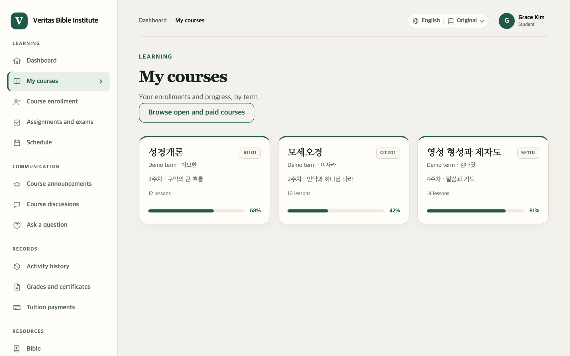
Opening a course
PART 4 · TAKING CLASSES
1
My courses on the left
A card for each course you've signed up and paid for.
1
2
Click a course card
2
The green bar and % show how much you've done.
Cards also show your current grade, or Completed once you finish.
Online Campus Student Guide · Part 4 Taking classes · p. 21
Notes:
Continue learning on the dashboard also takes you straight into the course. The small arrow next to My courses on the left lists your current courses so you can pick one directly. Course titles appear in the language the instructor wrote them in; to read them translated, use the book (Original) menu at the top right (page 13).

Slide 22
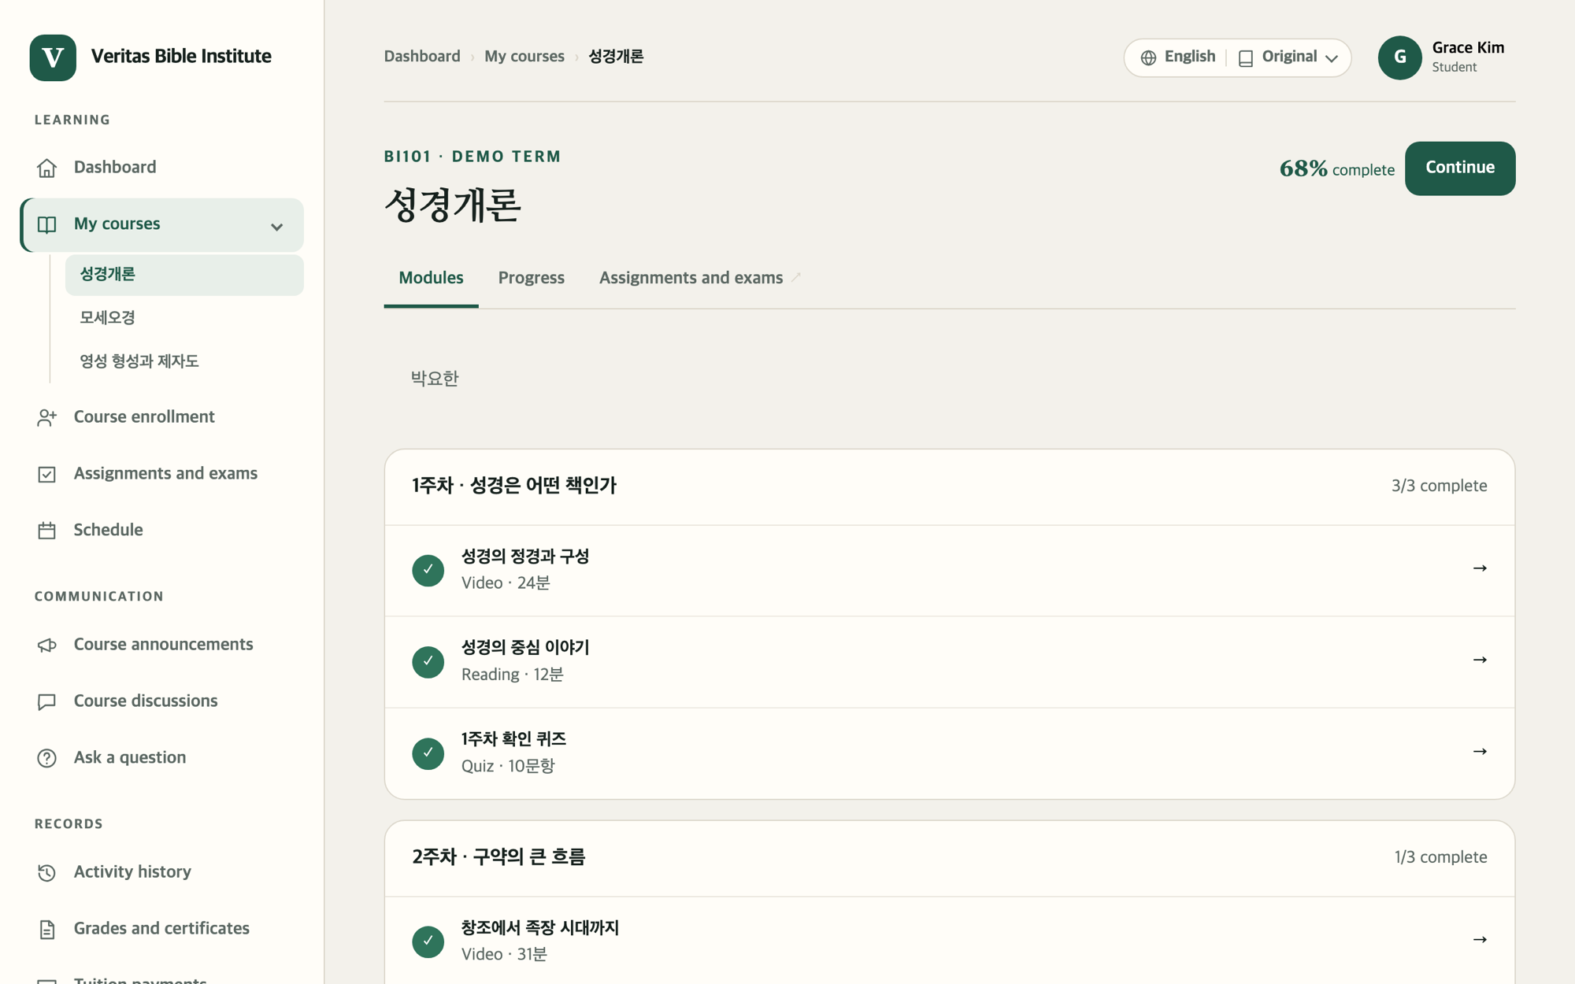
Reading the course page
PART 4 · TAKING CLASSES
1
Continue
Jumps to the next lesson you haven't finished.
2
Tabs across the top
1
Modules (the lesson list), Progress, Assignments and exams, Announcements, Attendance, Discussions
2
3
Click a lesson row to start
3
A green ✓ means you've finished that lesson.
A lesson that isn't open yet shows when it opens, for example "Opens Oct 12".
Online Campus Student Guide · Part 4 Taking classes · p. 22
Notes:
The number of tabs can differ a little by course. The sample shows no Announcements, Attendance or Discussions tabs, but real courses have them. Lessons are grouped by week, and the top right of each group shows how many are done, such as "3/3 complete".

Slide 23
Five kinds of lessons, five ways to finish
PART 4 · TAKING CLASSES
Kind | What you do | How it counts as done
Video | Press ▶ and watch | Watch over 90% and it's done automatically (p. 24)
Reading | Read the text or PDF | Click Mark as read (p. 25)
Zoom live | Join a class at a set time | Click Mark as complete (p. 26)
Assignment | Write, or upload a file | Click Submit assignment (p. 29)
Quiz | Answer the questions | Submit answers → graded at once (p. 30)
The kind is written in small letters next to each lesson's title, for example "Video · 24 min" or "Reading".
Online Campus Student Guide · Part 4 Taking classes · p. 23
Notes:
This one table sums up Parts 4 and 5. A lesson must be marked done before your progress goes up and Continue moves on to the next lesson.

Slide 24
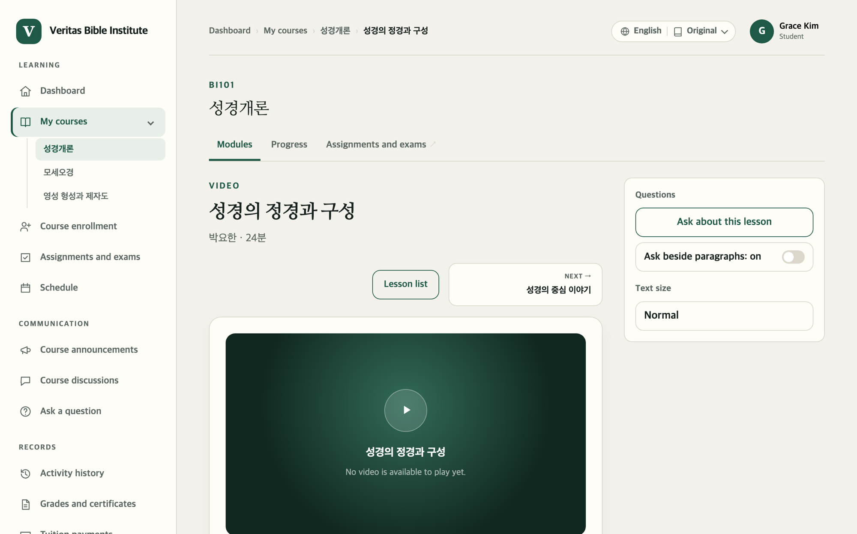

Watching a video lesson
PART 4 · TAKING CLASSES
1
Press ▶ play
Your watch time saves itself. It's fine to stop partway.
Watch over 90% and it's done
3
No button to click. "Progress ○○%" goes up as you watch.
2
2
Next →
Lesson list takes you back to the list of lessons.
1
3
Have a question? Ask right here
Ask about this lesson
Online Campus Student Guide · Part 4 Taking classes · p. 24
Notes:
Only the time you actually watch is saved, so skipping ahead may not raise your progress; watch to the end. Under the video, the lesson's goals and content are written out. Text size on the right makes the writing bigger.

Slide 25
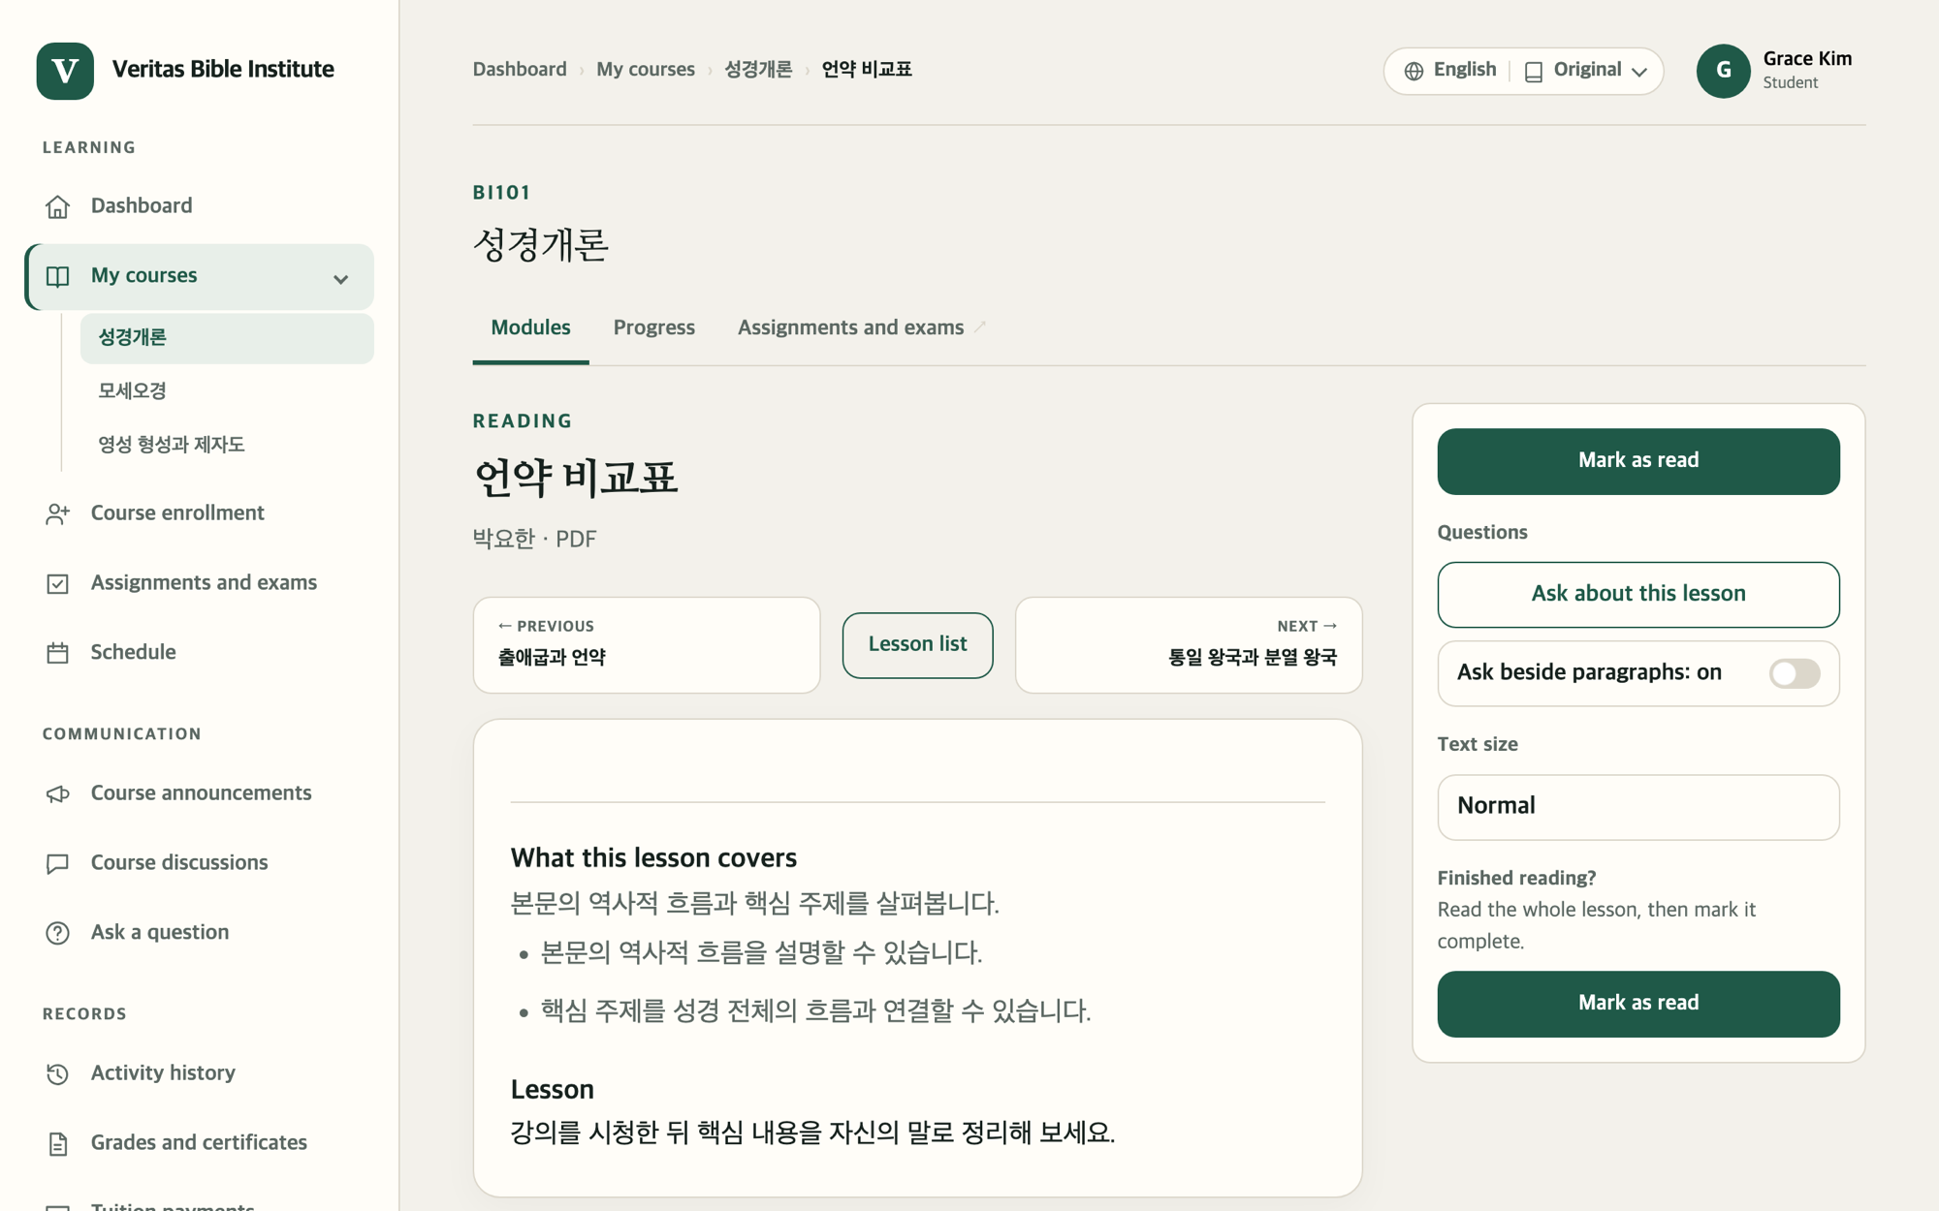
Finishing a reading lesson
PART 4 · TAKING CLASSES
1
Read to the end
Open attachments with Download or Open in a window. If there's a Listen button, you can listen instead.
2
Mark as read
2
The top and bottom buttons do the same. When it says Reading complete, you're done.
3
Clicked it by mistake?
Click Undo completion.
Text too small? Make it bigger with Text size on the right.
2
Online Campus Student Guide · Part 4 Taking classes · p. 25
Notes:
Unlike a video, a reading lesson only counts as done when you click Mark as read yourself. Without it, your progress won't go up.

Slide 26
Joining a live Zoom class
PART 4 · TAKING CLASSES
1
Check the start time
It's on the lesson page and under Schedule in the left menu.
Zoom live class
2
Click Join the class on Zoom ↗
● In progress
Zoom opens in a new window. You join once your instructor admits you.
Join the class on Zoom ↗
3
After class, click Mark as complete
When it changes to Marked complete, you're done.
Mark as complete
4
Missed it? Watch the recording ↗
○ Not started · ● In progress · ■ Ended
✓ Recording available
Only shown when a recording has been added.
▲ Sample live lesson screen
Online Campus Student Guide · Part 4 Taking classes · p. 26
Notes:
The box on the right is a drawn copy of a live lesson screen. If the status doesn't change, click Refresh status. A computer that has never used Zoom may ask whether to open the Zoom app. Your instructor takes attendance; check the result under Attendance (page 38).

Slide 27
Assignments and exams
PART 5
Your to-do list · Handing in an assignment · Taking a quiz · Reading the status labels
Online Campus Student Guide · p. 27

Slide 28
All your work in one place
PART 5 · ASSIGNMENTS AND EXAMS
1
Assignments and exams in the left menu
Activity | Due | Status
Message of the Prophets Assignment · Intro to the Bible | Sep 12, 11:59 PM | Not submitted
Week 1 Quiz Quiz · Intro to the Bible | — | Graded · 9 / 10
Covenant reflection notes Assignment · Pentateuch | Sep 19, 11:59 PM | Submitted · awaiting grading
To do now at the top lists what's due soonest.
2
Narrow the list
Set Status to Still to do and click Show.
3
Click a title
It opens that assignment or quiz.
▲ Sample list (course names and dates are examples)
Online Campus Student Guide · Part 5 Assignments and exams · p. 28
Notes:
What to do next on the dashboard shows the same items in short form. Page 31 explains the status labels. Due times are shown in your own time zone, which you can change under Notifications and settings.

Slide 29
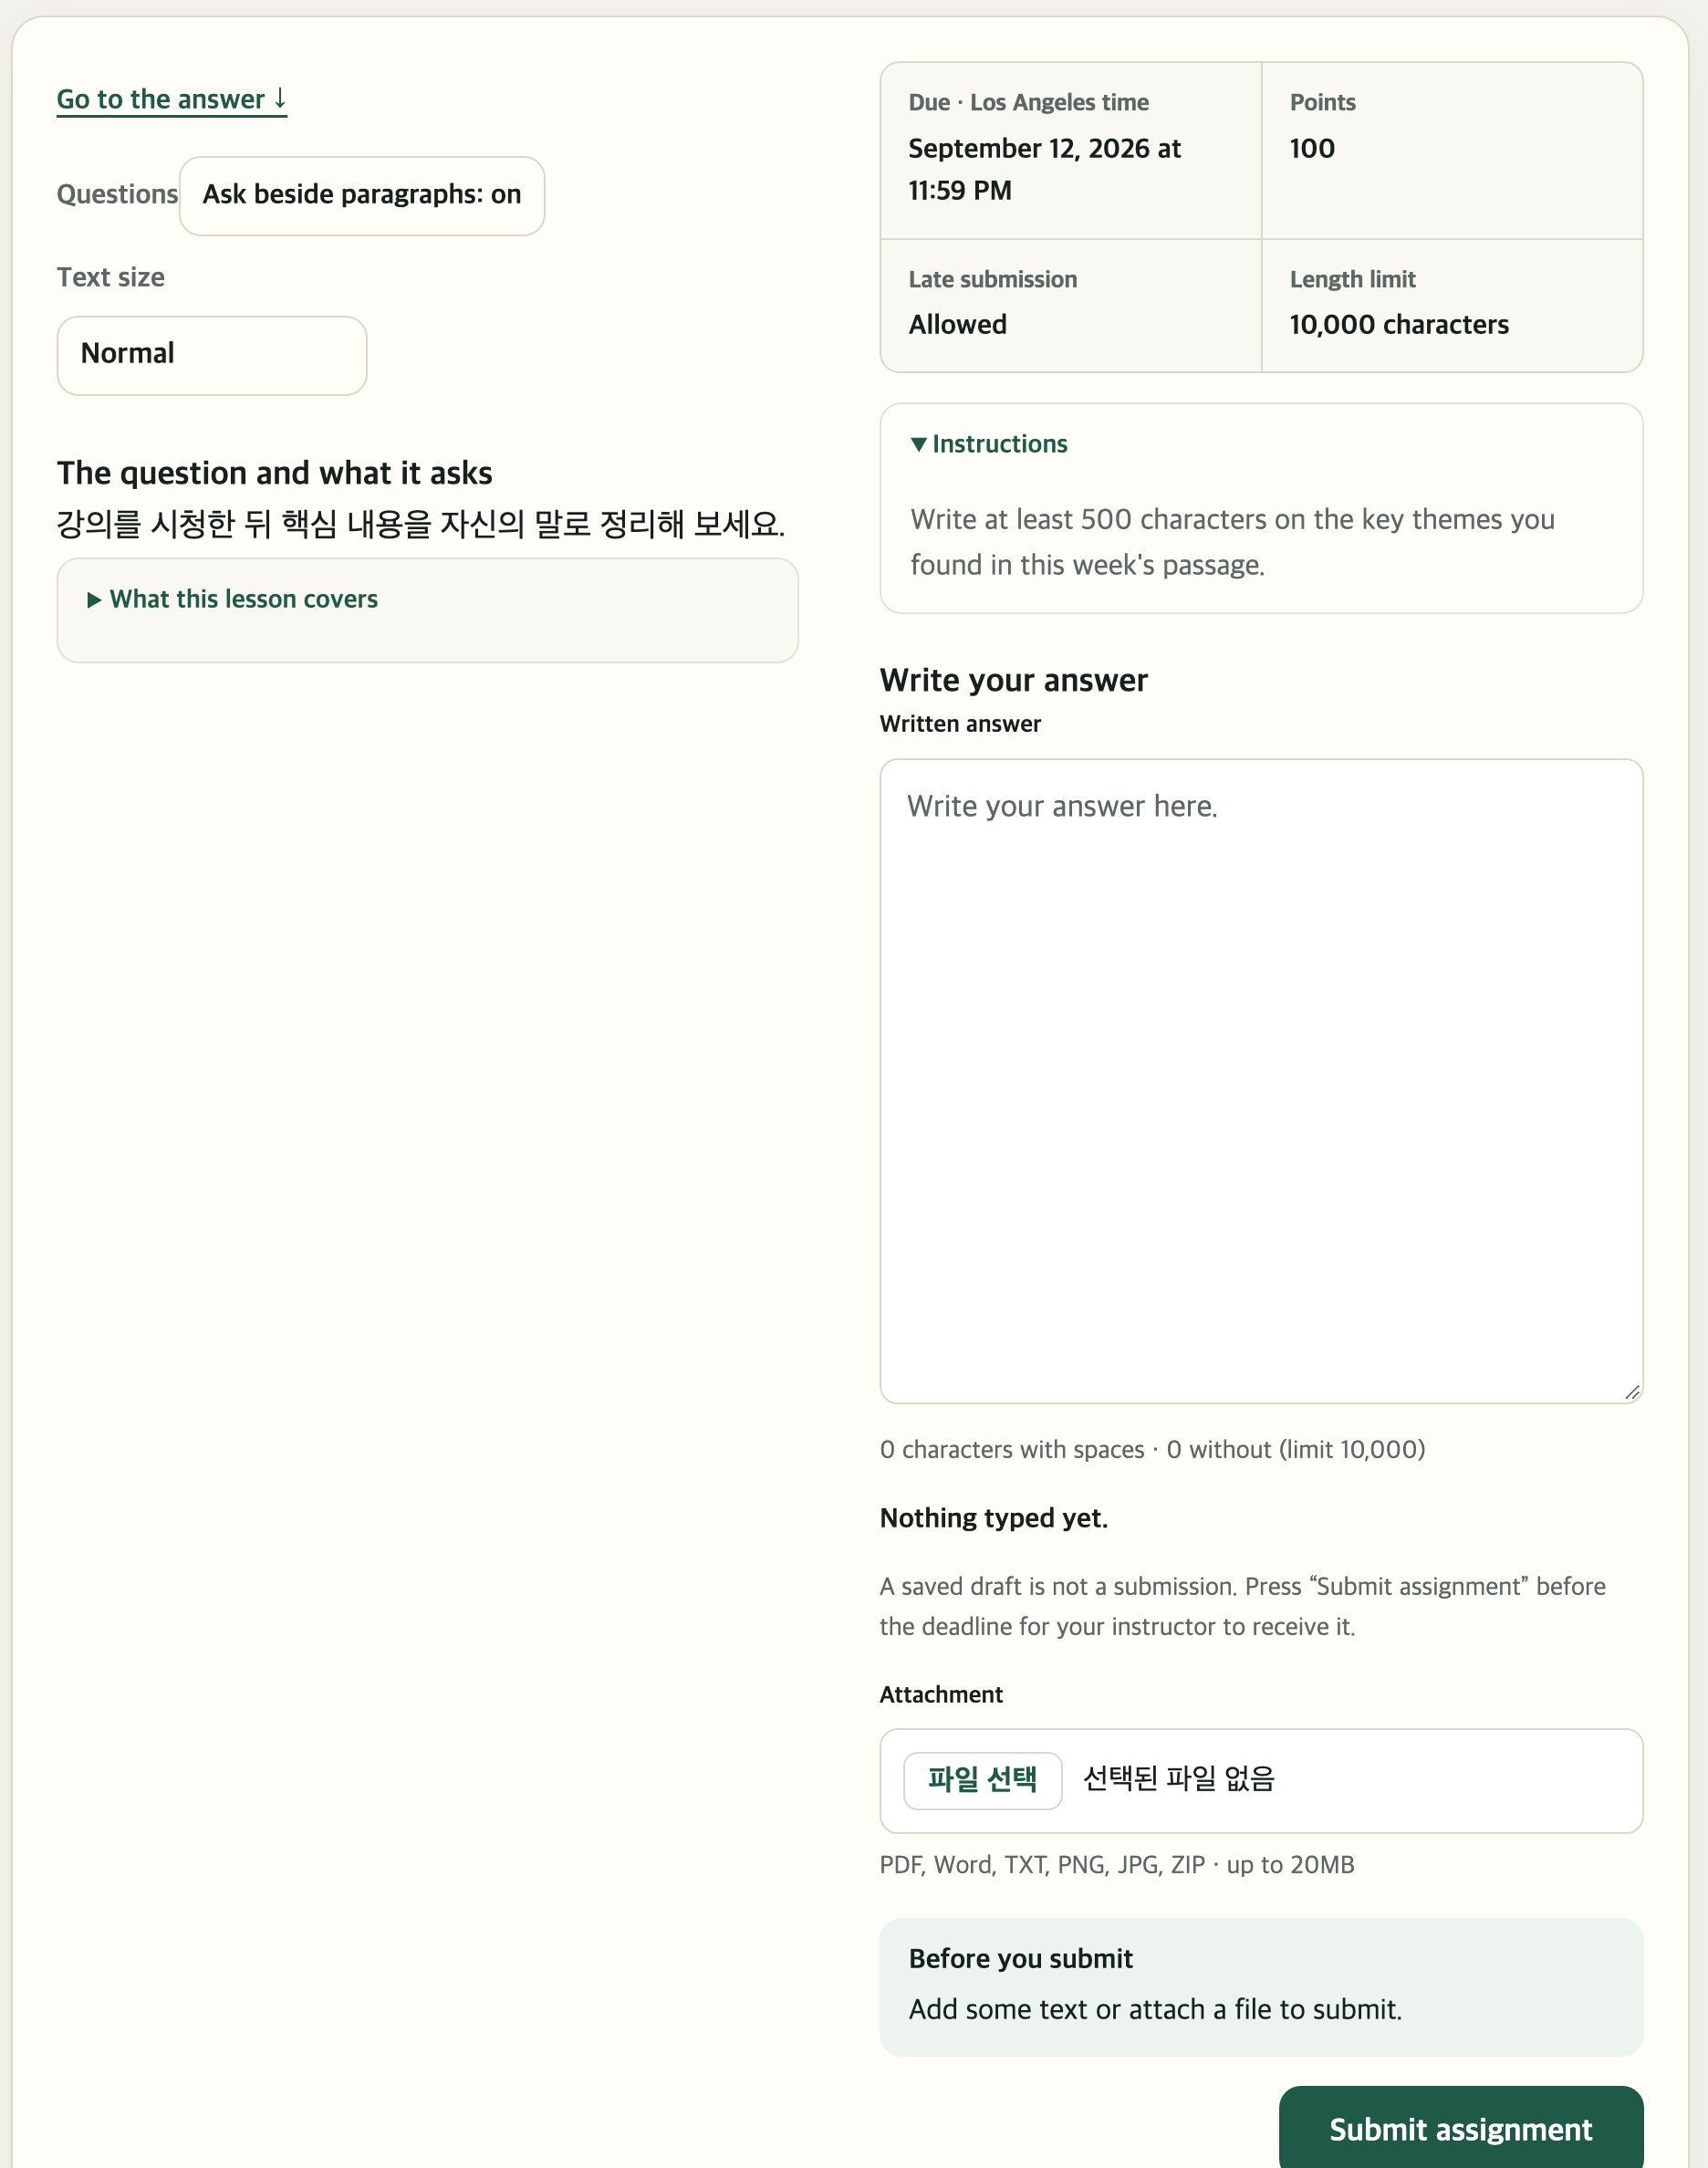
Handing in an assignment
PART 5 · ASSIGNMENTS AND EXAMS
1
1
Check the due date and points
Also see whether Late submission is allowed.
2
Write in the Written answer box
2
A draft is saved automatically as you type.
3
Handing in a file? Use the Attachment box
Click the file button, then pick a PDF, Word, TXT, PNG, JPG or ZIP file.
4
Submit assignment
Need to change it? Click Submit again before the deadline.
A saved draft is not a submission. Your instructor receives it only after you click Submit assignment.
3
4
Online Campus Student Guide · Part 5 Assignments and exams · p. 29
Notes:
You need either some text or a file to submit. Once graded, Instructor feedback appears on this same page and you get a notification. Go to the answer at the top left jumps straight to the answer box. The file button's wording comes from your own browser (for example, Choose File), so it may look different from the picture.

Slide 30
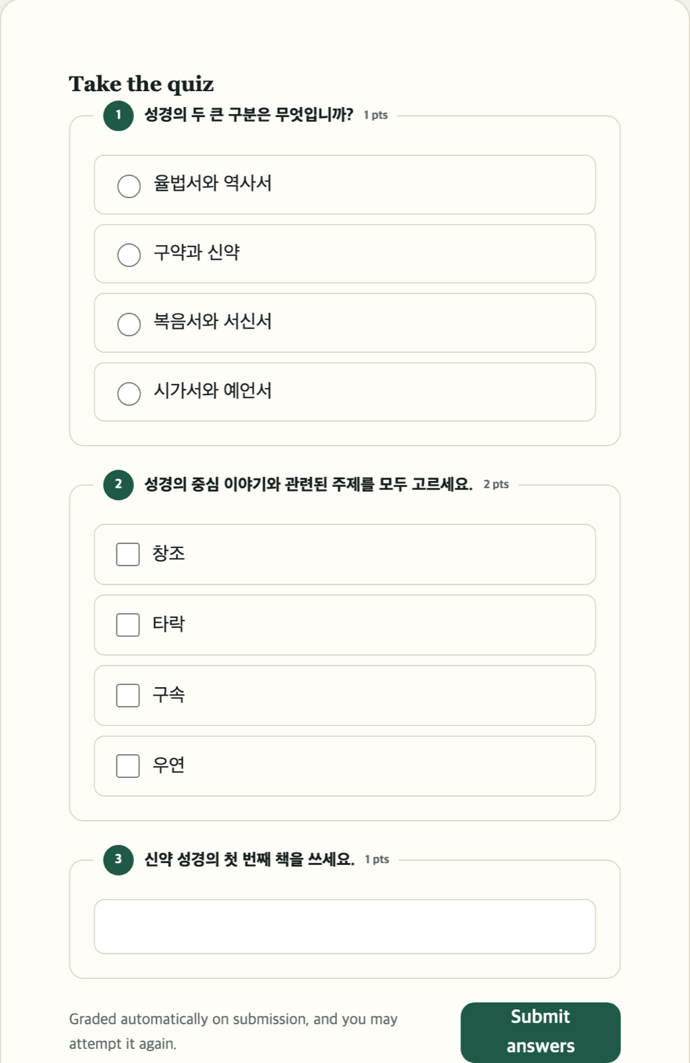
Taking a quiz
PART 5 · ASSIGNMENTS AND EXAMS
1
1
Circle ○ = pick one
Click the one right answer.
2
Square □ = pick all that apply
You can tick more than one.
3
Empty box = short answer
2
Click the box and type your answer.
4
Submit answers
It's graded at once and your score appears.
If you see Take it again, you can retake it. Your best score counts toward your grade.
3
4
Online Campus Student Guide · Part 5 Assignments and exams · p. 30
Notes:
A timed quiz tells you at the start, for example "The time limit is 10 minutes." The correct answers aren't shown; instead you're pointed to what to review. The results show your score, the score counted toward your grade, and how many times you've taken it.

Slide 31
What the status labels mean
PART 5 · ASSIGNMENTS AND EXAMS
Label | Meaning | What to do
Not submitted | You haven't handed it in | Submit before the deadline
Submitted · awaiting grading | It arrived; your instructor is grading it | Wait
Graded | Your score is in (e.g. 85 / 100) | Read the feedback
Resubmission needed | Your instructor asked you to hand it in again | Fix it and click Submit again
… · past due | The deadline has passed | Ask your instructor if late work is allowed
Instructor feedback appears under Instructor feedback on the assignment page, in Recent feedback on the dashboard, and in your notifications.
Online Campus Student Guide · Part 5 Assignments and exams · p. 31
Notes:
The two rows in bold, Not submitted and Resubmission needed, are the ones where you need to act. Whether late work is accepted is shown as Late submission on each assignment page.

Slide 32
Staying in touch
PART 6
Course announcements · Course discussions · Asking a question · Notifications
Online Campus Student Guide · p. 32

Slide 33


Reading announcements, replying in discussions
PART 6 · STAYING IN TOUCH
Course announcements
Course discussions
1 Click Course announcements on the left
1 Click Course discussions on the left
2 Pick the term and course, click Show
2 Click a topic's title
3 Click a title to read it
3 Write in the reply box, click Post reply
News from your instructors and campus staff. Read-only; new announcements also arrive as notifications.
Everyone in the class can see it. You can edit a reply for 15 minutes after posting. Your instructor opens the topics.
Online Campus Student Guide · Part 6 Staying in touch · p. 33
Notes:
The Announcements and Discussions tabs at the top of the course page show the same thing. For a personal question that other students shouldn't see, use Ask a question instead (next page).

Slide 34

Ask a question: private, just for you
PART 6 · STAYING IN TOUCH
About what you're studying
When the site is hard to use
A question about the course
A question about using the site
Choose the course under Which course?, then write a title and your question.
A button that won't work, a screen that looks wrong, payment questions and so on.
Send to my instructor
Send to the administrators
Answers arrive on the same page under Questions I sent. When Waiting for an answer changes to Answered, open it.
Online Campus Student Guide · Part 6 Staying in touch · p. 34
Notes:
Open it from Ask a question in the left menu. Questions are private and other students can't see them. While watching a lesson, you can also click Ask about this lesson on that page.

Slide 35

Notifications and settings
PART 6 · STAYING IN TOUCH
Checking notifications
Notifications and settings
1 Click New notifications at the top right
Your name → Notifications and settings
2 Read them in My notifications
Display time zone · makes deadlines show in your local time.
3 When done, click Mark as read
Notification preferences · tick what you want: announcements, grading and feedback, deadlines, discussion replies.
A link inside a notification, such as View the announcement, takes you straight there.
Each section has its own save button.
Notifications appear only inside the campus, not by email. Sign in a few times a week to check.
Online Campus Student Guide · Part 6 Staying in touch · p. 35
Notes:
New notifications shows only when something is unread. The same settings page also lets you change the display language and turn the Bible reading plan on or off. Email notifications are not available yet.

Slide 36
Records and resources
PART 7
Schedule · Grades and certificates · Attendance · Bible · My profile
Online Campus Student Guide · p. 36

Slide 37
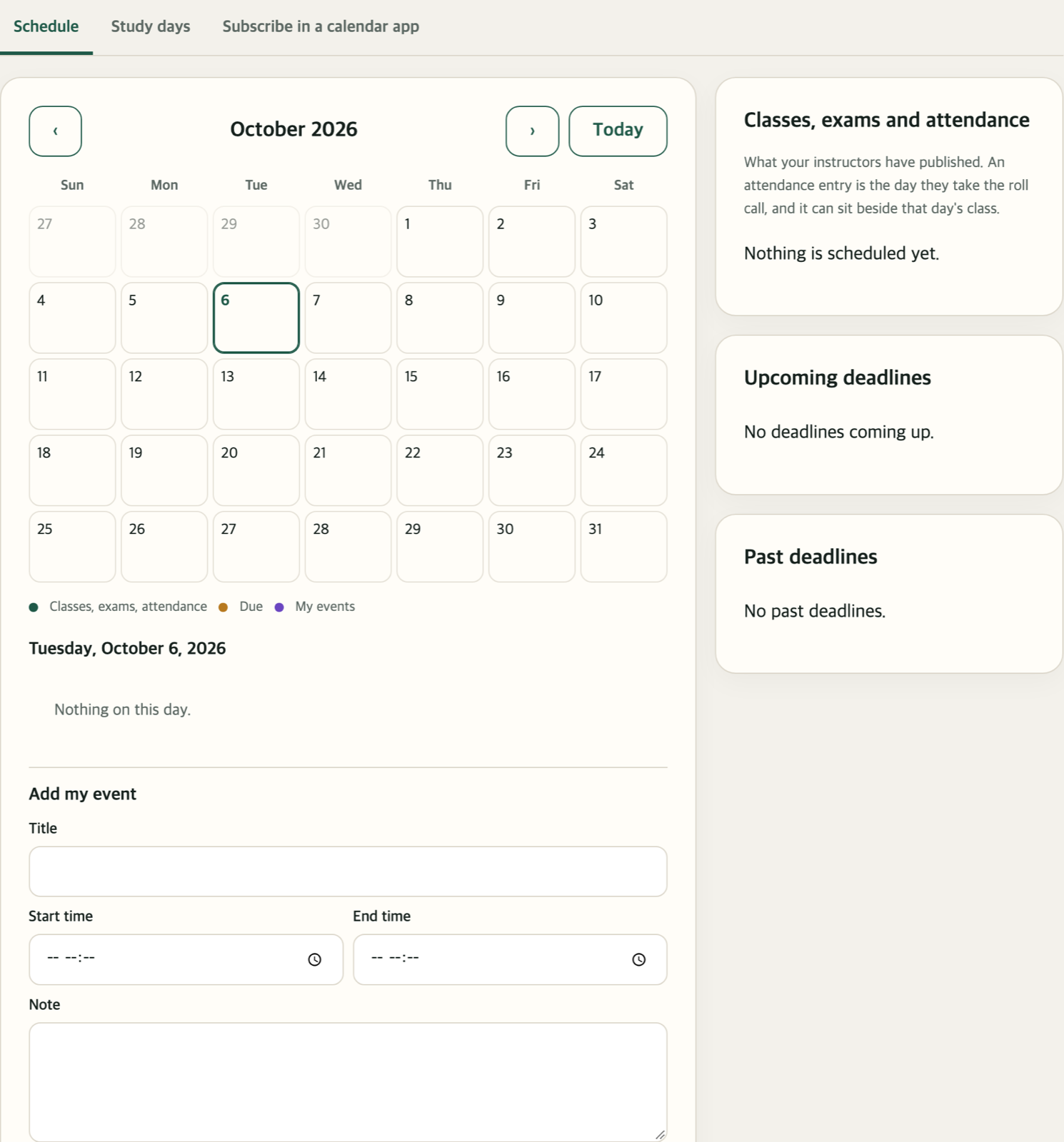
Your schedule and your own events
PART 7 · RECORDS AND RESOURCES
1
4
2
1
Schedule on the left → the Schedule tab
Dot colors: green = classes, exams, attendance; orange = due; purple = my events
2
Click a day
That day's events appear below.
3
Add my event
Fill in the title, times and a note, then click Add event. To remove one, click Delete.
3
4
The Study days tab
Pick the days you plan to study and click Save study days. It helps you keep a rhythm.
Online Campus Student Guide · Part 7 Records and resources · p. 37
Notes:
The picture shows an empty sample schedule. In real use, classes, exams, attendance and assignment deadlines from your instructors appear as dots on the calendar. The Subscribe in a calendar app tab lets you see the campus schedule in your phone's calendar app.

Slide 38
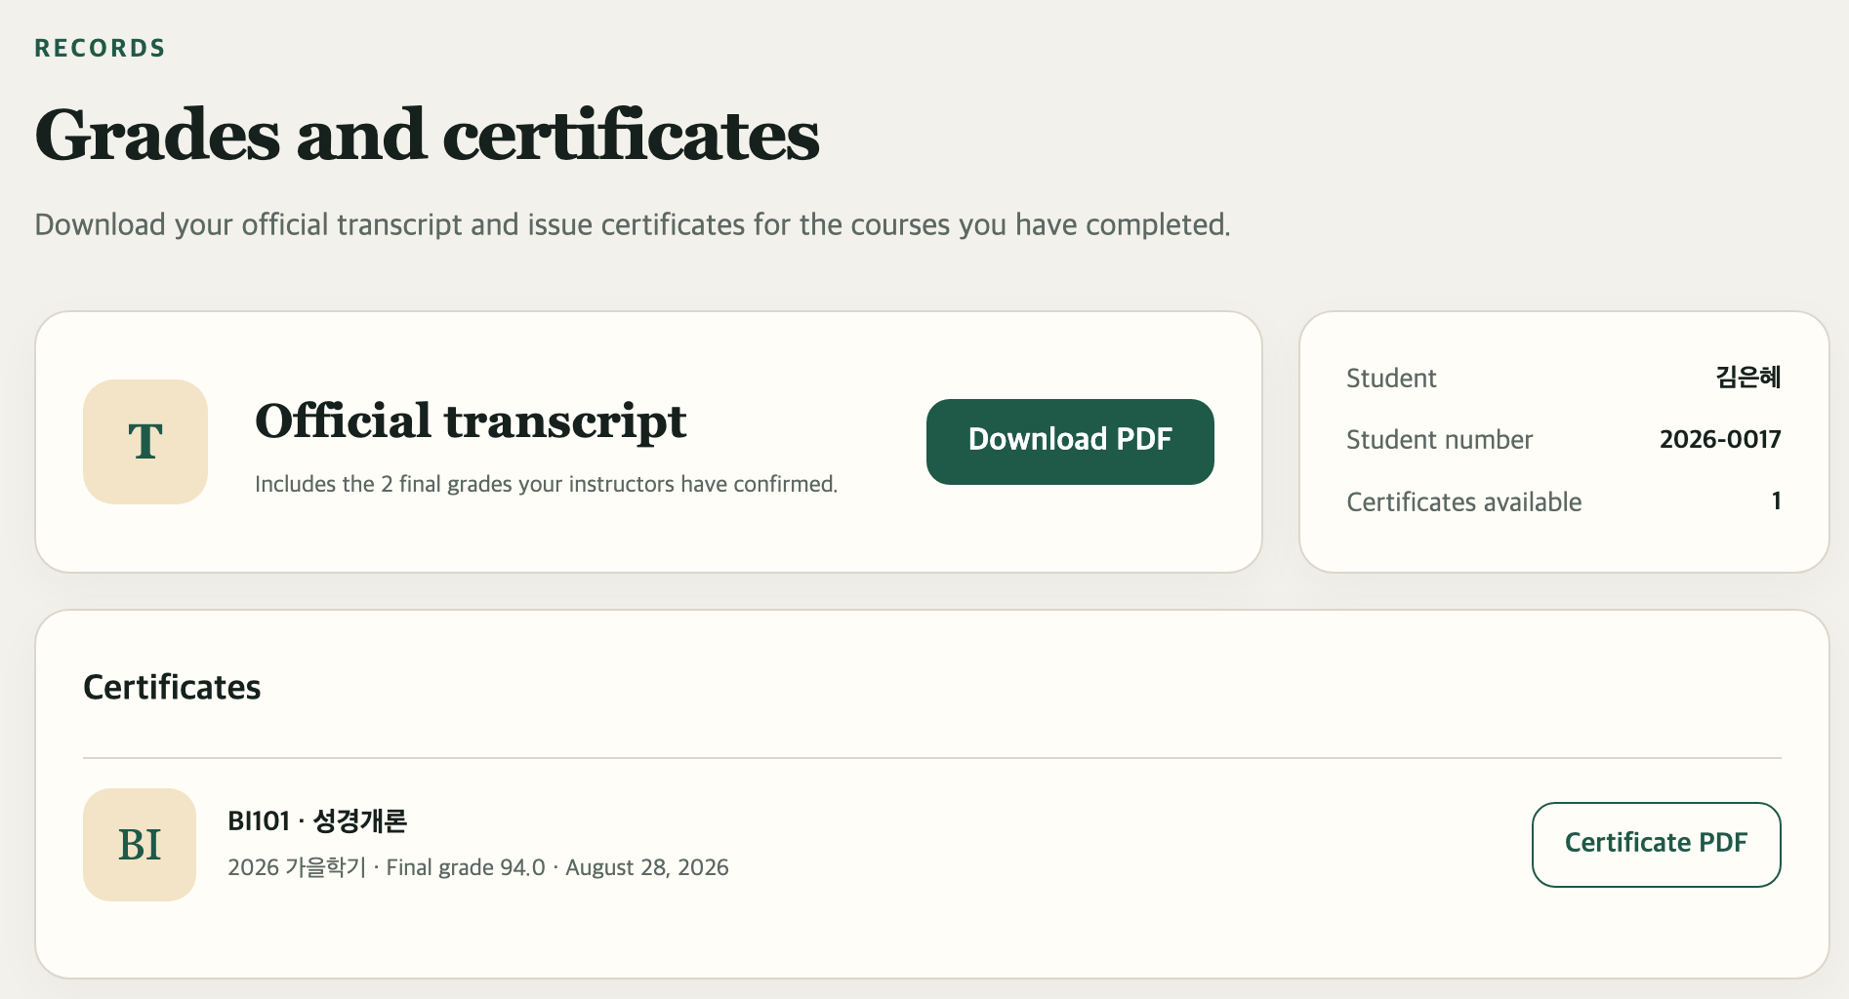
Grades, certificates, attendance, activity
PART 7 · RECORDS AND RESOURCES
1
Download PDF
Your official transcript, under Grades and certificates on the left.
2
Certificate PDF
One for each course you've completed.
1
Grades in progress · Grades so far on the same page, or your My courses cards
Attendance · the Attendance tab on the course page: present, late, absent
2
Activity history · on the left: what you've done, day by day
Online Campus Student Guide · Part 7 Records and resources · p. 38
Notes:
The official transcript includes only grades your instructor has confirmed. Attendance is taken by your instructor, so you can only view it, not change it. Downloaded PDFs go to your computer's Downloads folder.

Slide 39
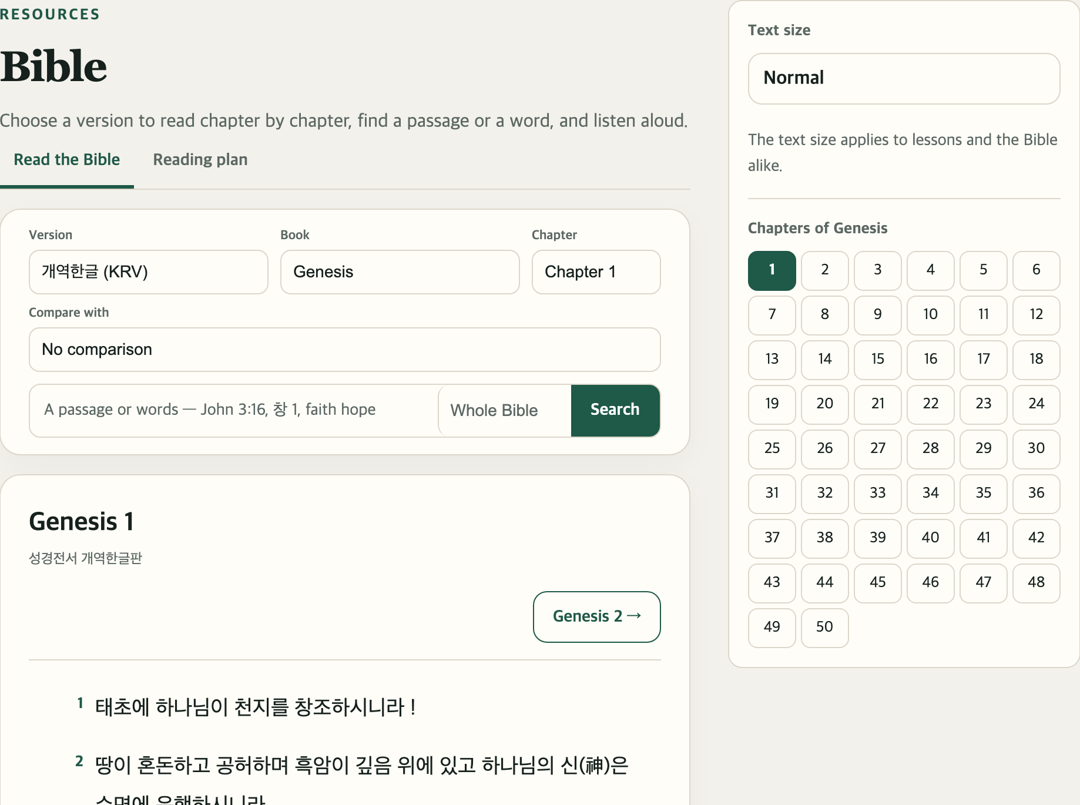
Reading and listening to the Bible
PART 7 · RECORDS AND RESOURCES
1
4
1
Read the Bible · Reading plan
2
The reading plan sets a passage for each day.
2
Choose a version, book and chapter
3
Pick one under Compare with to see two translations side by side.
3
Search by passage or word
For example: John 3:16, faith hope
4
Click a chapter number
Listen to this chapter reads it aloud for you.
Online Campus Student Guide · Part 7 Records and resources · p. 39
Notes:
Open it from Bible at the bottom of the left menu. The reading-plan check is off at first: on the Reading plan tab click Use the reading plan and choose a start date, and you'll see each day's reading and your record. Text size at the top right makes the words bigger.

Slide 40



Your profile
PART 7 · RECORDS AND RESOURCES
Your name at the top right → My profile
Profile picture
What you can change
What you can't
Upload a photo of yourself, or pick a drawn avatar and click Use this avatar.
Name you go by and Phone. Then click Save.
Your name and email. Your name is printed on transcripts and certificates, so contact campus staff to change it.
To change your password: sign out → on the sign-in page click Forgot your password? (same as page 9)
Online Campus Student Guide · Part 7 Records and resources · p. 40
Notes:
Photos can be JPG, PNG or WebP and are cropped to a square automatically. The profile page has no change-password button of its own.

Slide 41
Common questions
WHEN YOU'RE STUCK
I can't find a course I signed up for
I watched the video but it isn't done
A reading lesson won't finish
A paid course shows up in My courses once payment is confirmed. Check Tuition payments. (p. 17)
Actual watch time must pass 90%. Watch the parts you skipped. (p. 24)
You need to click Mark as read yourself. (p. 25)
I wrote my assignment but it says Not submitted
The email never arrived
Deadlines show the wrong time
Check your spam folder. Only the newest password email works. (p. 9)
Set your time zone in Notifications and settings. (p. 35)
It was only saved as a draft. Click Submit assignment to hand it in. (p. 29)
Online Campus Student Guide · p. 41
Notes:
If that doesn't solve it, see where to get help on the next page. When a screen looks odd, reloading the page (the round arrow at the top of the browser) or signing out and back in often fixes it.

Slide 42
Where to get help
WHEN YOU'RE STUCK
A question about the course
Trouble using the site
Can't sign in at all
Ask a question → about the course, or Ask about this lesson on the lesson page
Ask a question → about using the site. Your name → Help has the same buttons.
Email Veritas Institute of the Bible.
office@veritasbibleinstitute.org
Or send a question from the campus home page. No sign-in needed.
veritas.cabible.org/#ask
Slowly, one step at a time, is plenty. We're cheering you on.
Online Campus Student Guide · p. 42
Notes:
The Contact link at the bottom of the home page also sends campus staff an email, if a contact address has been set.

